Slide 1


Department of Computer Science and Engineering
PREDICTION OF MATERNAL HEALTH USING CLASSIFICATION METHOD WITH HARDWARE
MANJU S [211419104161]
RAVEENA M [211419104219]
SHANMUGA PRIYAA B [211419104247]
GUIDE:
Dr.K.VALARMATHI M.E,Phd
COORDINATOR:
Dr.K.VALARMATHI M.E,Phd

Slide 2
Introduction
Ladies are the mainstays of any family and society however maternal passing during pregnancy and labour is an extraordinary misfortune to a child, family, society, and country.
Most maternal passing happen because of preventable causes including draining after birth, dangerous early terminations, blocked work, hypertension, discharge, and hypertensive problems, cracked uterus, hepatitis, weakness, and so on.

Slide 3
Objective of the Project
To predict the health condition of the pregnant women.
The maternal health data has been collected and different machine learning algorithm are used for the prediction of the maternal health.
The Trained Machine learning model takes the parameters regarding the maternal women as input and then predicts the risk level of maternal health.

Slide 4
Literature Survey
YEAR | TITLE | AUTHOR | DESCRIPTION | ADVANTAGES | DISADVANTAGES
2023 | “Maternal Risk Level Prediction Using Ensemble Model”. | Nirmala , Rekha S Kambli | The work has created a system for accurately monitoring and forecasting a pregnant woman's risk level. Pregnant women's health information and risk factors will be examined by this method to determine the risk intensity level. | To identify significant risk component for evaluating, categorizing, and predicting risk intensity, a different strategy has been taken. The dataset's maximum accuracy is provided by the ensemble random forest model. | It doesn’t make use of hybrid model for prediction in which the accuracy of the result may be more accurate.
2022 | "Prediction Model for Mortality Analysis of Pregnant Women Affected With COVID-19" | Quazi Adibur Rahman Adib Sidratul Tanzila Tasmi,Shahriar Islam Bhuiyan, Mohsin Sarker Raihan,etal | The machine learning models that have been used in our study are support vector machine, decision tree, random forest, gradient boosting, and artificial neural network. The model have provided impressive results and can accurately predict the mortality of pregnant mothers with a given input. | The model can be utilized by healthworkers globally to list down emergency patients, which can ultimately reduce the death rate of COVID-19 diagnosed pregnant mothers. | The health condition will be uncertain for each and every individual based on the age and examination time and region of the patients in these data were unknown

Slide 5
Literature Survey
YEAR | TITLE | AUTHOR | DESCRIPTION | ADVANTAGES | DISADVANTAGES
2022 | "Analysis and Prediction of Gestational Diabetes Mellitus by the Ensemble Learning Method". | Xiaojia Wang,Yurong Wang, Shanshan Zhang, Lushi Yao, Sheng Xu | The prediction model studies divide the population into low-risk, medium-risk and high-risk groups according to the probability of disease to provide a basis and direction for personalized diagnosis and treatment and comprehensive intervention in clinical practice | The new integrated model has a good effect in predicting gestational diabetes mellitus. It is possible to improve the accuracy of diagnosis of the disease to improve maternal and infant outcomes as early as possible. | The examination time and region of the patients in these data were unknown, and the analysis results may be different by time and region. It is difficult to explain the inherent complexity of the variable interactions.
2022 | "Predicting perinatal mortality based on maternal health status and health insurance service using homogeneous ensemble machine learning methods” | DawitS. Bogale, TesfamariamM. AbuhayBelaynh E. Dejene | The data were pre-processed to get quality data that are suitable for the homogenous ensemble machine-learning algorithms to develop a model that predicts perinatal mortality. We have applied and wrapper feature selection methods. After selecting all the relevant features. | Risk factors of perinatal mortality were identified using feature importance analysis and relevant rules were extracted using the best performing model. | The limitation of this study is we were not able to measure the effect of the model in the real-world environment.

Slide 6
Literature Survey
YEAR | TITLE | AUTHOR | DESCRIPTION | ADVANTAGES | DISADVANTAGES
2022 | "A Catalogue of Machine Learning Algorithms for Healthcare Risk Predictions" | Argyro Mavrogiorgou,Athanasios Kiourtis, Spyridon Kleftakis, Konstantinos Mavrogiorgos, Nikolaos Zafeiropoulos and DimosthenisKyriazis | The proposed mechanism utilizes seven widely used and well-established ML algorithms, namely the BNB, KNN, DT, RF, LR, NN, and SGD, to train models to perform predictions across diverse healthcare anomalies’ scenarios | This study is useful in assisting the selection of classification algorithms for future applications that exploit relevant health-related data. | Failed to test the current ML algorithms in distributed environments and datasets by utilizing state-of-the-art techniques such as Federated Learning (FL).
2021 | "Predictive behaviour of maternal health inputs and child mortality in West Bengal – An analysis based on NFHS-3" | SaswatiChaudhuri, Biswajit Mandal | The joint estimation technique which is a Full Information Likelihood Method (FILM). This takes care of the problem of unobserved heterogeneity which is likely to be present in this kind of research.We have estimated three binary probit equations with the three outcome variables viz. PC, HD, and CM. | This study would help policymakers to identify areas to stress upon in order to pave way for the formation of good quality human capital in the long run. Another distinguishing feature of this paper is use of joint estimation. | The analysis becomes less relevant if we fail to identify the factors responsible for the mothers and the households to be exposed to the outcome of child mortality. We find that hospital delivery translates to lower child mortality.

Slide 7
Problem Statement
Around the world, in excess of 200 million ladies become pregnant every year. Although most pregnancies end with a live child to a solid mother, at times, the occasion is a period of agony, enduring, and even demise. Truth be told, an expected 585,000 ladies kick the bucket every year, and another 20 million ladies foster persistent, incapacitating diseases because of pregnancy-related difficulties. Of these maternal passing’s, an expected almost 100% occur in emerging nations. the proposed method is to predict whether the gestation period of maternal health is risky or not. This can be predicted by a machine learning method.

Slide 8
Existing System
DRAWBACKS
Deep learning is implemented which results in low accuracy.
CTG which is harm to pregnant women is used to measure the heart rate.

Slide 9
Proposed System
The main aim of the proposed method is to predict whether the gestation period of maternal health is risky or not.
This can be predicted by a machine learning method.
Reduces the risk level of pregnant women by measuring the heart rate using sensors.
Many algorithms are used and the best one is used for predicting maternal health.

Slide 10
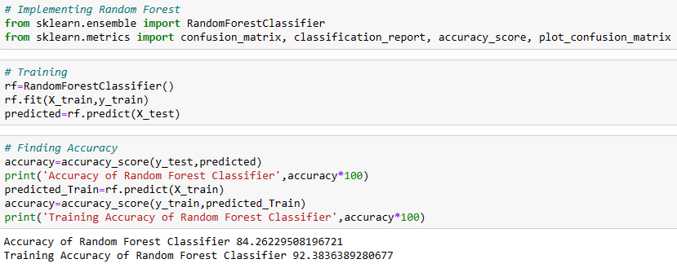
Proposed Algorithm

Slide 11
Software / Hardware used
HARDWARE REQUIREMENTS
Processor : Intel i3
Hard disk : minimum 10 GB
RAM : minimum 4 GB
SOFTWARE REQUIREMENTS
Operating System : Windows 10 or later
Tool : Anaconda with Jupyter Notebook

Slide 12
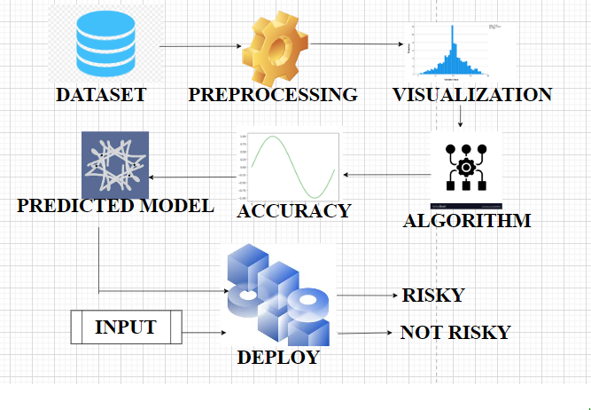
System Architecture

Slide 13
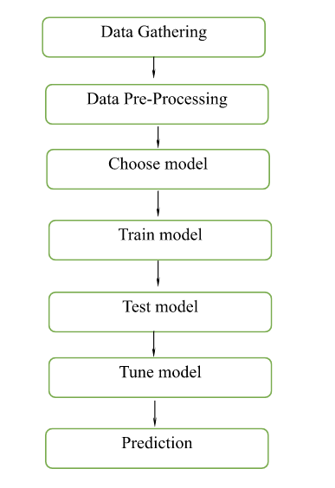
System Design - Flow Chart

Slide 14
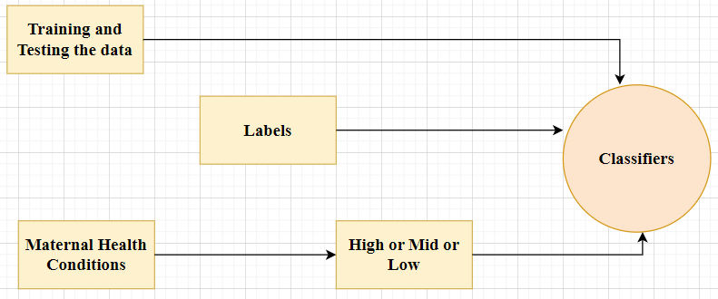
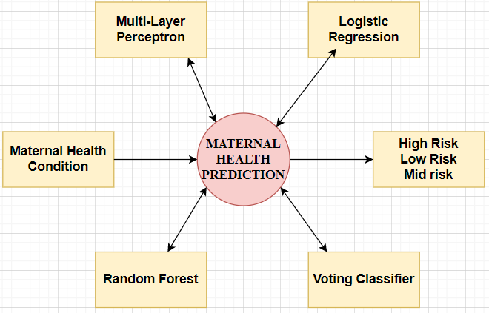
System Design –Data Flow Diagram
LEVEL 0
LEVEL 1

Slide 15
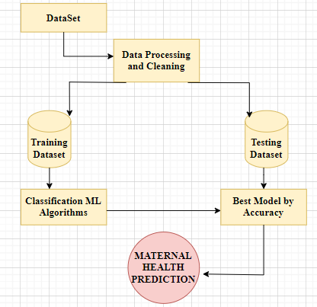
System Design – Data Flow Diagram (Contd..)
LEVEL 2

Slide 16
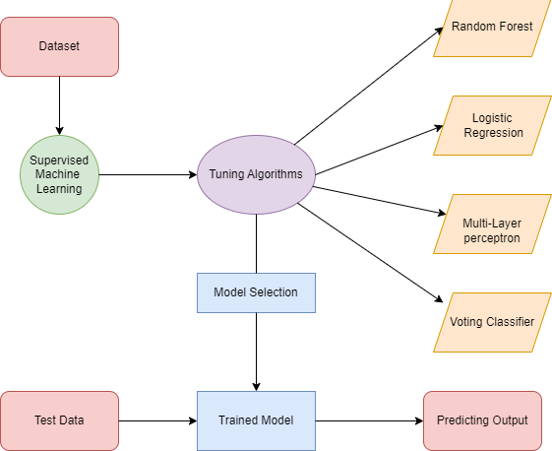
System Design – Entity Relationship Diagram

Slide 17
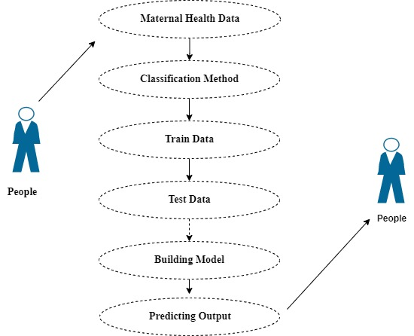
System Design – Use Case Diagram

Slide 18
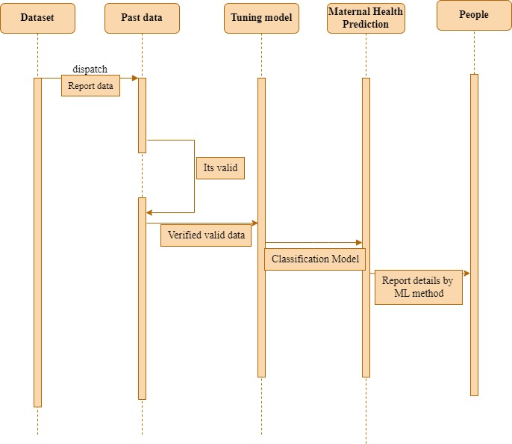
System Design – Sequence Diagram

Slide 19
Module Description
DATA PRE-PROCESSING
Data preprocessing is a process of preparing the raw data and making it suitable for a machine learning model. It is used to remove the redundant data from the dataset.
DATA VISUALIZATION
Data visualization provides an important suite of tools for
gaining a qualitative understanding. This can be helpful when exploring and getting to know a dataset and can help with identifying patterns, corrupt data. It can be used to express and demonstrate key relationships in plots and charts.

Slide 20
Module Description(Contd..)
RANDOM FOREST
Random Forest works in two-phase first is to create the random forest by combining N decision tree, and second is to make predictions for each tree created in the first phase.
MULTI-LAYER PERCEPTRON
A multilayer perceptron is a neural network connecting multiple layers in a directed graph, which means that the signal path through the nodes only goes one way. Each node, apart from the input nodes, has a nonlinear activation function.

Slide 21
Module Description(Contd..)
LOGISTIC REGRESSION
Logistic regression is a Machine Learning classification algorithm that is used to predict the probability of certain classes based on some dependent variables. In short, the logistic regression model computes a sum of the input features and calculates the logistic of the result.
VOTING CLASSIFIER
A Voting Classifier is a machine learning model that trains on an ensemble of numerous models, predicts an output based on their highest probability of chosen class as the output. It simply aggregates the findings of each classifier passed into Classifier and predicts the output based on the highest Voting majority of voting.

Slide 22
Module Description(Contd..)
DEPLOYMENT PROCESS
In this module the trained Machine learning model is converted into pickle data format file (.pkl file) which is then deployed in any framework for providing better user interface and predicting the output of how much the given data is Predicting the WSN Attack.

Slide 23
Testing and Results
TEST CASE ID | INPUT | EXPECTED OUTPUT | OBTAINED OUTPUT | PASS/FAIL | REMARKS
TC01 | Dataset | Successful import | Successful import | Pass | Imported successfully
TC02 | Dataset | Pre-process successful | Pre-process successful | Pass | Pre-processed successfully
TC03 | Dataset | Model creation | Model created | Pass | Model created successfully
TC04 | Model | Successful compilation | Successful compilation | Pass | Model compiled successfully
TC05 | Model | Successful loading of model | Successful loading of model | Pass | Model loaded successfully
TC06 | Health Parameters | Successful Prediction of low risk | Successful Prediction of low risk | Pass | Prediction Successful
TC07 | Health Parameters | Successful Prediction of low risk | Successful Prediction of low risk | Pass | Prediction Successful
TC08 | Health Parameters | Successful Prediction of low risk | Successful Prediction of low risk | Pass | Prediction Successful

Slide 24
Performance Evaluation
CLASS | Precision | Recall | F1-score | Support
HIGH RISK | 0.97 | 0.90 | 0.94 | 82
LOW RISK | 0.85 | 0.82 | 0.83 | 122
MID RISK | 0.75 | 0.82 | 0.78 | 101
ACCURACY | - | - | 0.84 | 305
MACRO AVERAGE | 0.86 | 0.85 | 0.85 | 305
WEIGHTED AVERAGE | 0.85 | 0.84 | 0.84 | 305

Slide 25
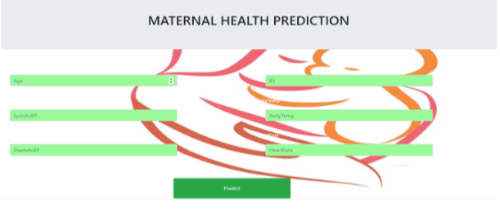
Screen Shots
Front Page

Slide 26
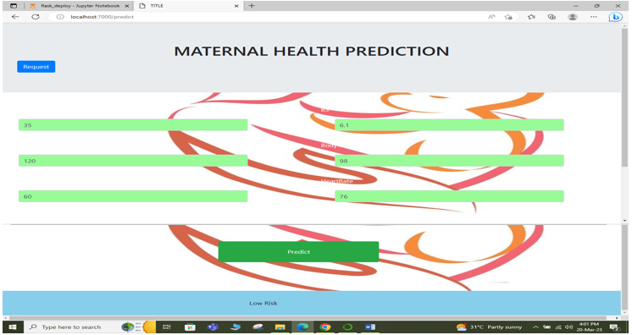
Screen Shots
Prediction of Low Risk

Slide 27
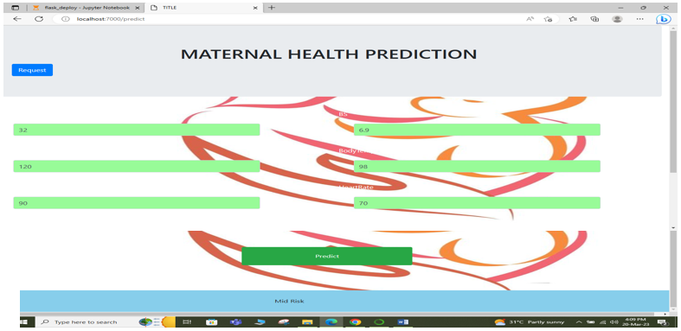
Screen Shots
Prediction of Mid Risk

Slide 28
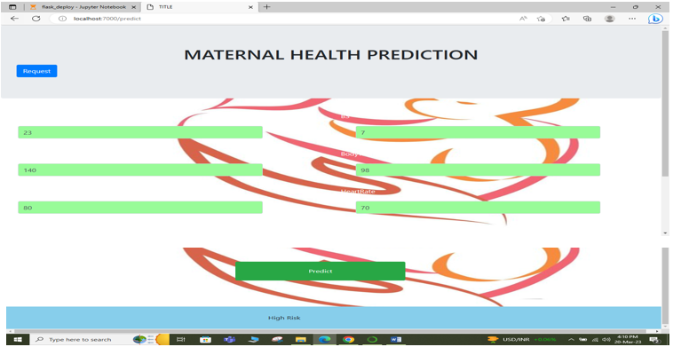
Screen Shots
Prediction of High Risk

Slide 29
Conclusion / Feature Enhancement
The analytical process started from data cleaning and processing, missing value, exploratory analysis and finally model building and evaluation. The Best accuracy on a public test set is higher accuracy score will be found out. This model can predict a woman's maternal health status based on the comparison of four algorithms. It may also allow for the early provision of additional assistance for women who are at risk of not giving birth in a medical institution, potentially improving maternal and fetal health outcomes. The paradigm described here is transferable to different situations, and the choice of input features can be readily modified to meet data accessibility and various outcomes, including those related to an unrelated to maternal health. In future the model should predict the Maternal health and prescribe proper medication and to connect with the AI Model. To automate this process by showing the prediction result in web application or desktop application. To optimize the work to implement to AI Environment.

Slide 30
Reference Paper
[1] Nirmala, Rekha S Kambli (2023) "Maternal Risk Level Prediction Using Ensemble Model",Volume 11.
[2] Quazi Adibur Rahman Adib Sidratul Tanzila Tasmi,Shahriar Islam Bhuiyan, Mohsin Sarker Raihan,etal, (2022)"Prediction Model for Mortality Analysis of Pregnant Women Affected With COVID-19",DOI:10.1109/ICCIT54785.2021.9689824.
[3]Xiaojia Wang,Yurong Wang, Shanshan Zhang, Lushi Yao, Sheng Xu, (2022) "Analysis and Prediction of Gestational Diabetes Mellitus by the Ensemble Learning Method",Article number: 72.
[4]Julio Jerison E. Macrohon ,Charlyn Nayve Villavicencio,X. Alphonse Inbaraj and Jyh-Horng Jeng, (2022) "A Semi-Supervised Machine Learning Approach in Predicting High-Risk Pregnancies in the Philippines", DOI:10.3390 /diagnostics 12112782.
[5] Faheem Akhtar,Jianqiang Li,Janith Zahid Hussain Khand,etal, (2022)"An Efficient Small for Gestational Age Prognosis System Using Stacked Generalization Scheme (SGS)",DOI: 10.1109/ COMPSAC 54236.2022.00231
[6]Ali Raza,Hafeez Ur Rehman Siddiqui,Kashif Munir,Mubarak Almutairi ,Furqan Rustam,etal (2022),"Ensemble learning-based feature engineering to analyze maternal health during pregnancy and health risk prediction", https://doi.org/10.1371/journal.pone.027655
[7] Dawit S. Bogale, Tesfamariam M. Abuhay ,Belayneh E. Dejene, (2022)"Predicting perinatal mortality based on maternal health status and health insurance service using homogeneous ensemble machine learning methods", https://doi.org/10.1186/s12911-022-02084-1
[8] Argyro Mavrogiorgou , Athanasios Kiourtis , Spyridon ,etal, (2022)"A Catalog of Machine Learning Algorithms for Healthcare Risk Predictions",Doi:10.3390/s22228615
[9] Alma Fredriksson, Isabel R. Fulcher, Allyson L. Russell,etal, (2022)"Machine learning for maternal health: Predicting delivery location in a community health worker program in Zanzibar",Volume4,https://doi.org/10.33/fdgth.2022.85523.

Slide 31
Reference Paper (Contd..)
[10]Muhammad Nazrul Islam, Sumaiya Nuha Mustafina, Tahasin Mahmud & Nafiz Imtiaz Khan (2022) "Machine learning to predict pregnancy outcomes: a systematic review, synthesizing framework and future research agenda ", Article number: 348.
[11] João Alexandre Lobo Marques,Tao Han, Wanqing Wu,Aloísio Vieira Lira Neto,etal, (2021) "IoT-Based Smart Health System for Ambulatory Maternal and FetalMonitoring",
DOI:10.1109/JIOT.2020.3037759.
[12] L. Meng, K. Ge, Y. Song, D. Yang, and Z.Lin, (2021)"Wearable electrocardiogram signal monitoring and analysis based on convolutional neural network,”DOI:10.1109/ TIM.2021.3072144.
[13] Saswati Chaudhuri , Biswajit Mandal (2021) "Predictive behavior of maternal health inputs and child mortality in West Bengal – An analysis based on NFHS-3" , https://doi.org/10.1016/j.heliyon.2020.e03941
[14] Rema Ramakrishnan, Shishir Rao,Jian-RongHe, (2022)"Perinatal health predictors using artificial intelligence: A review",
DOI: 10.1177/17455065211046132
[15] Kabir Ahmad , Enamul Kabir, (2021)"Maternal health and health-related behaviors and their associations with child health: Evidence from an Australian birth cohort", https://doi.org/10.1371/journal.pone.0257188

Slide 32
THANK YOU !!!

